Slide 1

AJ Ecom Pvt Ltd .
AJ ECOM
Decode 9.1 Python Hackathon.
~Ashish Kushwaha

Slide 2

INTRODUCTION
AJ Ecom Pvt Ltd is one of the leading business who have supermarkets across different regions of India.
The Data provided is for the year 2011-2014.
There are three datasets provided –customer.csv , prod_cat_info.csv and transaction.csv.
The data is fetched from Four store types – Flagship store, E-shop, Teleshop and MBR.
Presentation Link: https://drive.google.com/file/d/1OWvlcDt4d-0UDgiv8umkmEeqG34sid7C/view?usp=sharing

Slide 3
PROBLEM STATEMENT
What are the Total Number of Transactions from 2011 to 2014?
What are the orders done monthly?
What is the minimum and maximum order quantity for a product?
Find the minimum and maximum transactions done?
What is the total sales done per year?
Find the number of customers visiting store?
Find the number of Stores ?
Which gender - males or females prefer more for store ?
What percent of gender do more shopping?
Show the distribution of Customers according to age and gender.
What percent of products are sold in market?
Which store has the highest sales?
Name the product category in which maximum tax is added ?
.Which product is maximum and minimum sold?

Slide 4

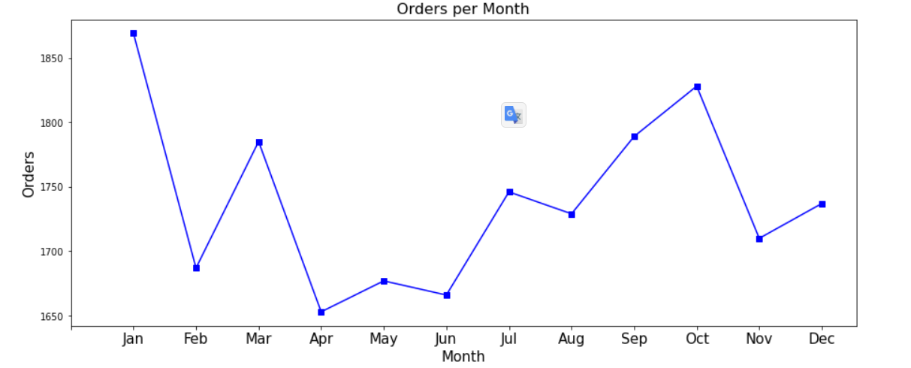
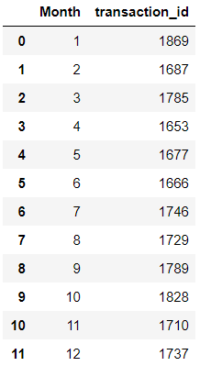
What are the orders done monthly?
The Maximum sales is in the month of January ie. 1869.

Slide 5
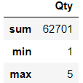
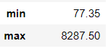
What is the minimum and maximum order quantity for a product?
Find the minimum and maximum transactions done?
What are the Total Number of Transactions from 2011 to 2014?

Slide 6

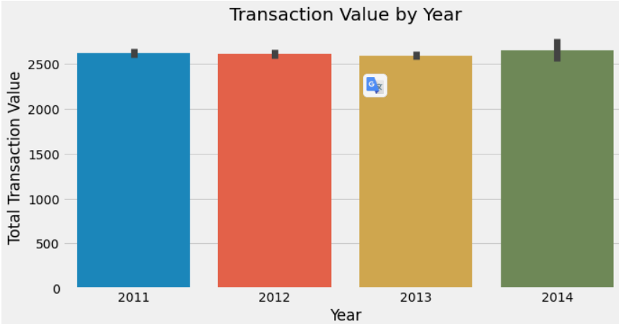
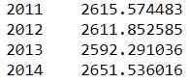
What is the total sales done per year?
According to the Data, The Average amount maximum earned in year 2014 and minimum earned in 2013

Slide 7
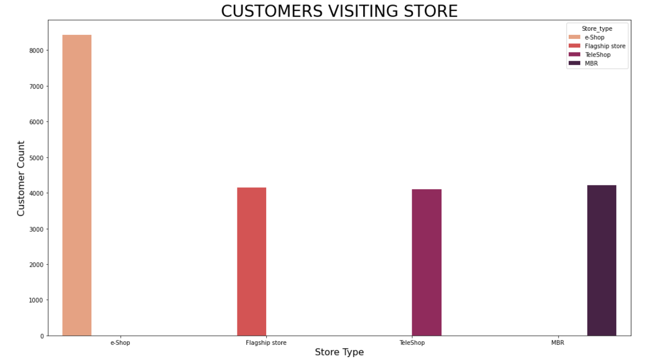
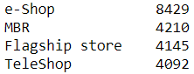
Find the number of customers visiting store ?

Slide 8
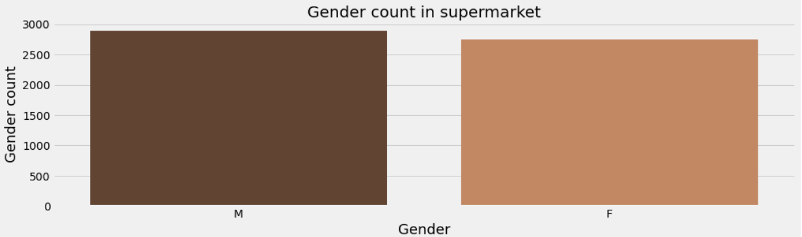
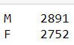
Which gender - males or females prefer more for store ?
Here we can see that the number of males and females entering the store is almost equal. But the visualization looks suspicious. Let's check numeric data

Slide 9
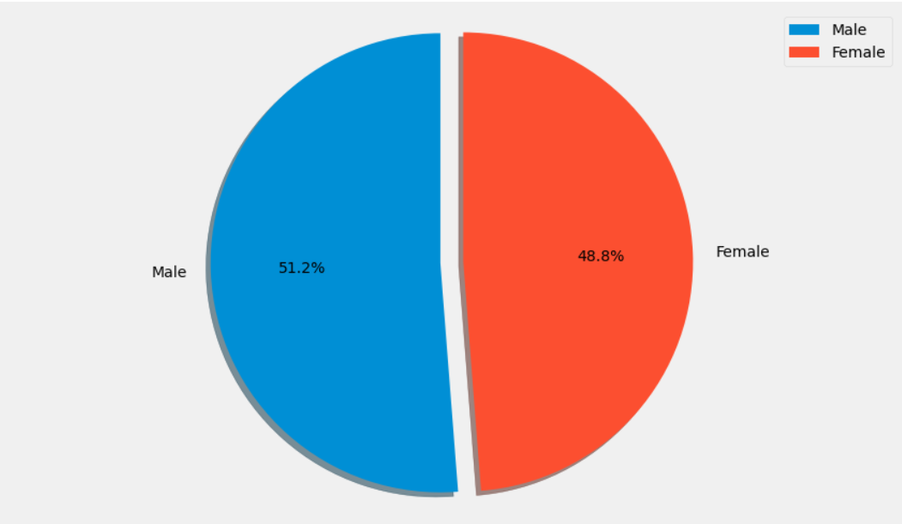
What percent of gender do more shopping?

Slide 10

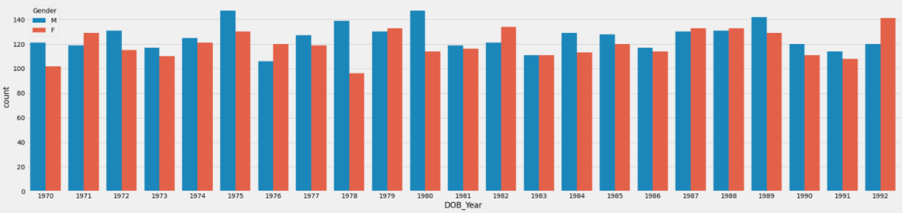
Show the distribution of Customers according to age and gender.

Slide 11
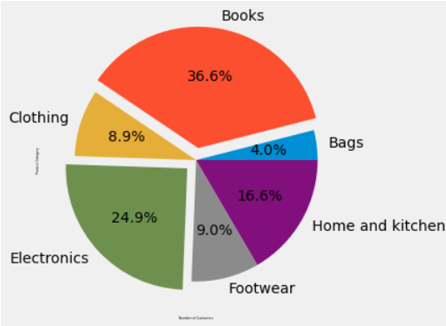
What percent of products are sold in market?

Slide 12
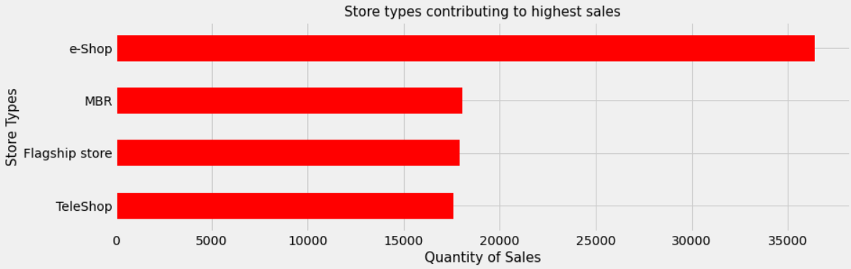
Which store has the highest sales?

Slide 13
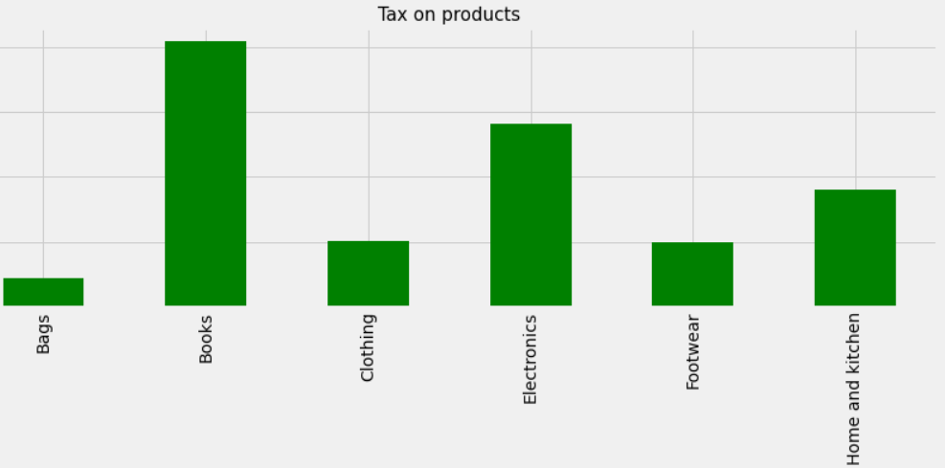
Name the product category in which maximum tax is added ?

Slide 14
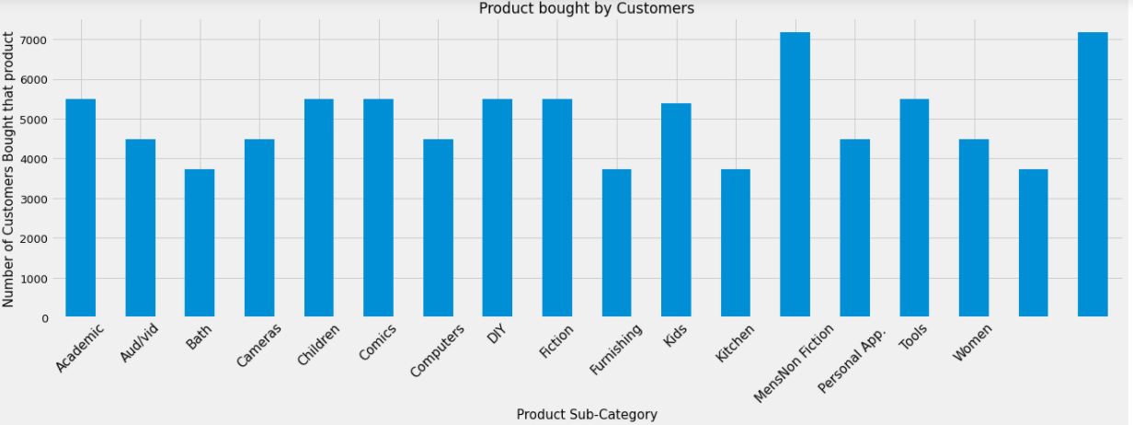
Which product is maximum and minimum sold?

Slide 15
Thank you!
AJ ECOM
Ashish Kushwaha
Email:
Phone:
kushwahaashish022@gmail.com
9118180089

